Slide 1
Task – 2 Submission
Internship Studio Internship for Ethical Hacking

Slide 2
Reflected cross-site scripting vulnerability in the search was found.
Site Name: Acunetix
URL : http://testasp.vulnweb.com/
Details : Reflected cross-site scripting (or XSS) arises when an application receives data in an HTTP request and includes that data within the immediate response in an unsafe way.
Solutions:
Validate & Sanitize Inputs: Check and clean user input on server-side to remove harmful code.
Content Security Policy (CSP): Restrict script loading to trusted sources only.
Encode Outputs: Render any remaining malicious characters harmless before displaying them.

Slide 3
Impact
When an attacker injects malicious scripts into a website (XSS attack), they can gain almost complete control over the victim's experience within that application. This includes:
1. Mimicking the victim's actions (anything the victim can do, the attacker can do too).
2. Accessing any information the victim can see.
3. Tampering with data the victim can modify.
4. Launching further attacks that appear to come from the victim.
Attackers typically trick victims into clicking malicious links or opening emails containing the XSS code. These attacks can be targeted or widespread depending on the attacker's goals.
Reflected XSS attacks, where the malicious code comes from an external source, are generally less severe than stored XSS, where the attack resides within the vulnerable application itself.

Slide 4
STEPS INVOLVED:
Important Note: Testing for XSS vulnerabilities can be risky. It is important to only test on web applications that you are authorized to test. You should also be careful not to accidentally inject malicious code that could harm the web application or its users.
This method involves use of Burp Suite.
Configure your browser to use Burp Suite as a proxy. This will allow Burp Suite to intercept and analyze the traffic between your browser and the web application.
Turn on intercept mode in Burp Suite. This will cause Burp Suite to intercept all traffic between your browser and the web application.
Browse to http://testasp.vulnweb.com to test in your browser.
In Burp Suite, find the request that was sent to the target site
. This request will contain the user input that you want to test for XSS.
Modify the user input in the request to include a payload. An XSS payload is a piece of malicious code that will be executed by the web application if it is not properly sanitized.
Forward the modified request to the web application.
Observe the response from the web application. If the web application is vulnerable to XSS, the response will contain the malicious code that you injected.

Slide 5
10.You can also use XSS scripts in the Intruder section to attack the target site.
11.Here the request (payload) is “<script>alert(1)</script>”. Which is the XSS script that we found to successfully attack.
12.Further, we requested for the response in the browser. And verified it there.
13.This manner we can recreate the mentioned incident.

Slide 6
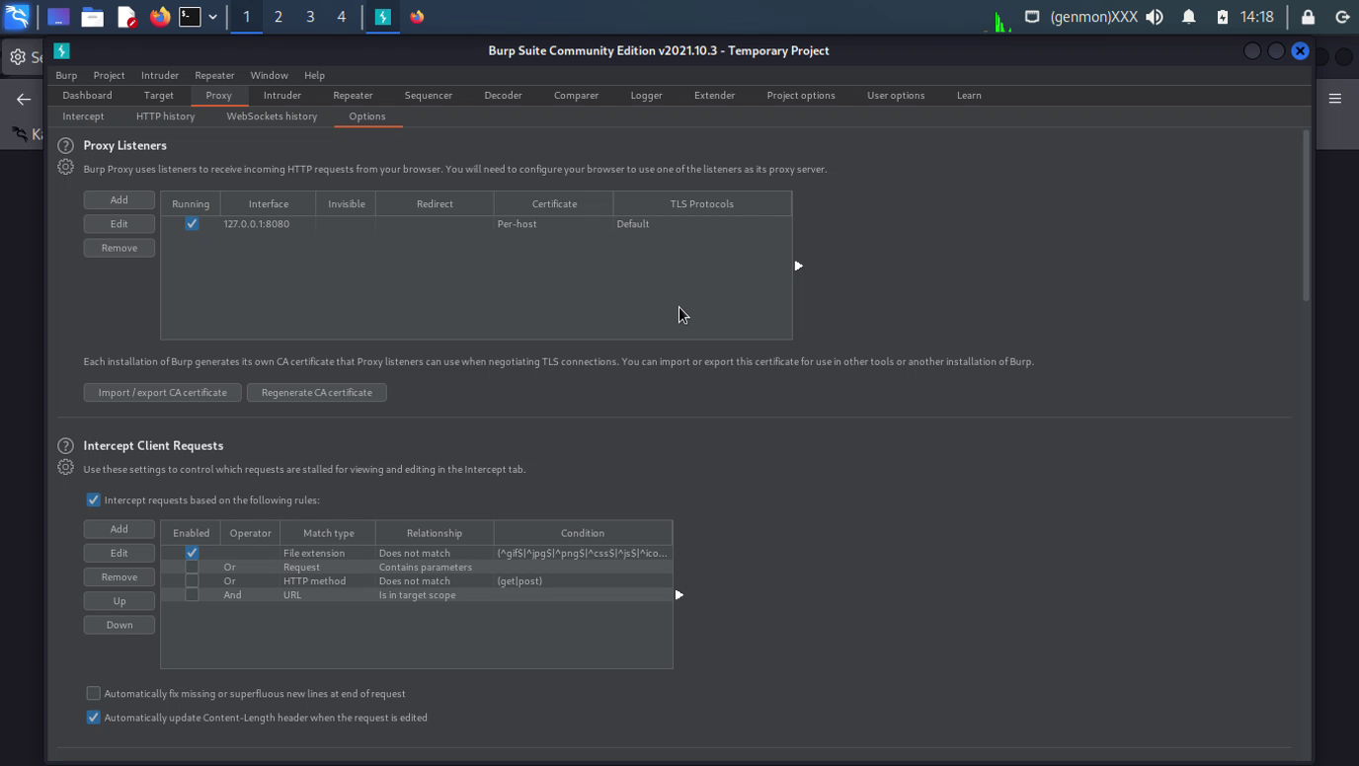
Proxy Setup

Slide 7
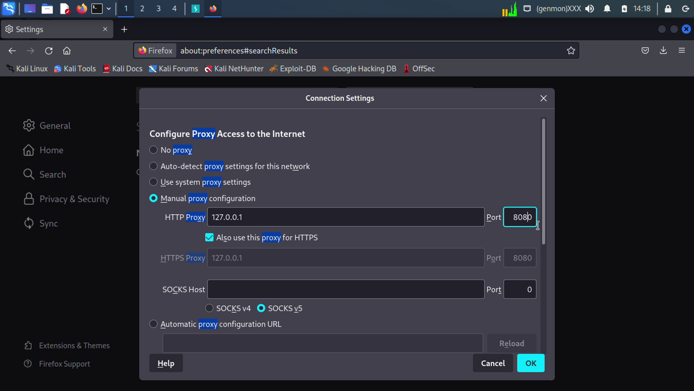
Proxy Setup

Slide 8
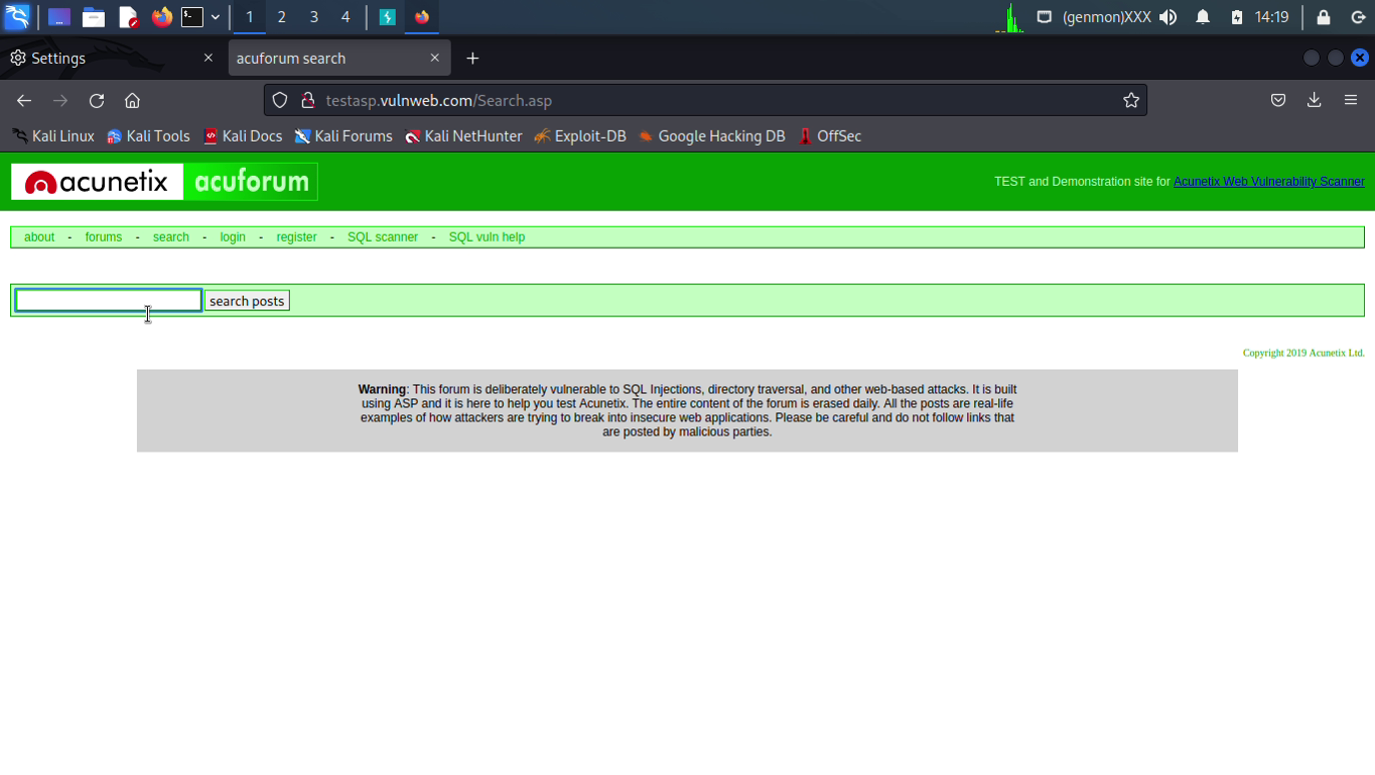
Target Site

Slide 9
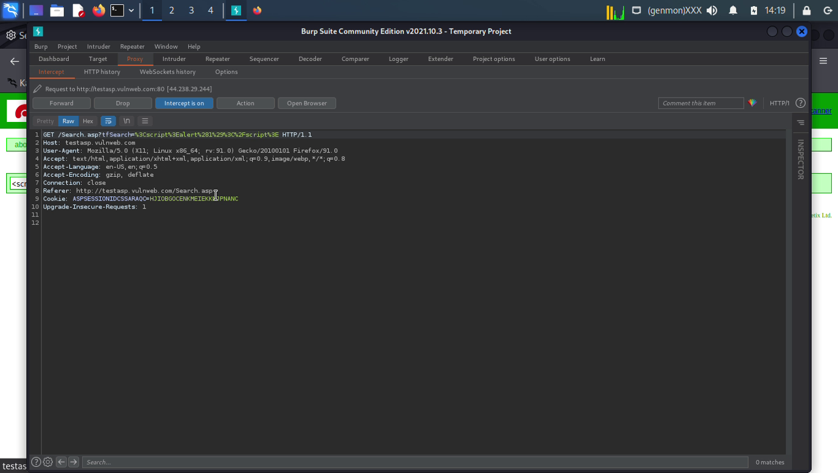
Intercepting in Burp Suite

Slide 10
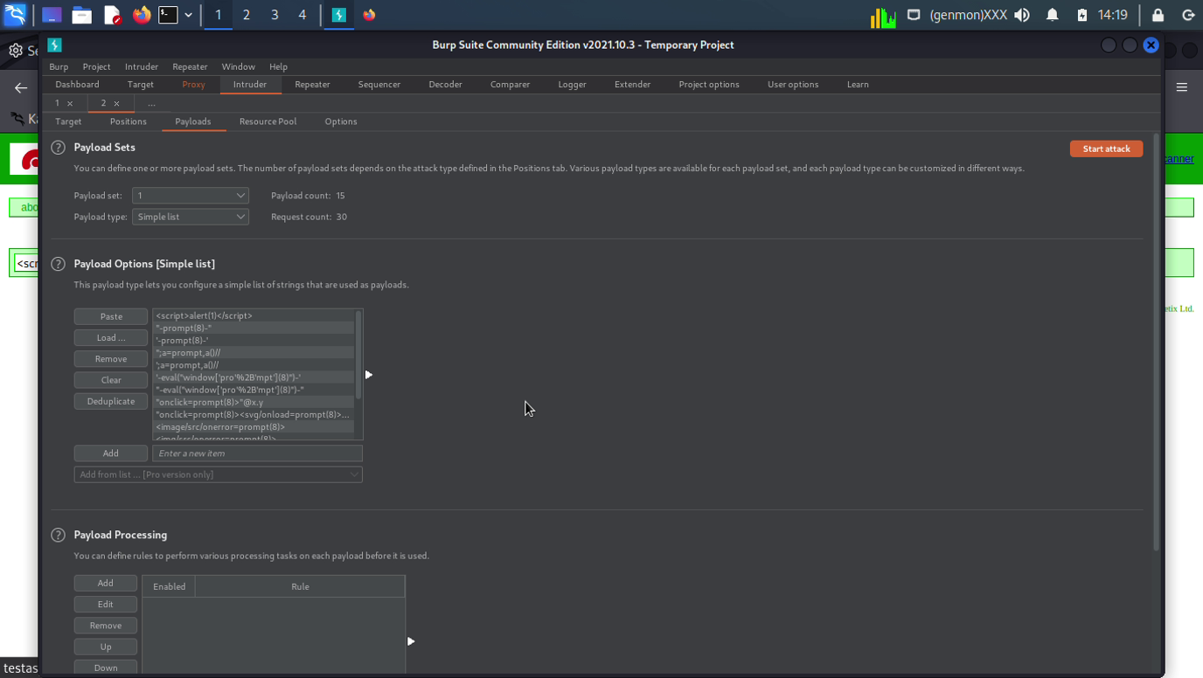
Payload Details

Slide 11
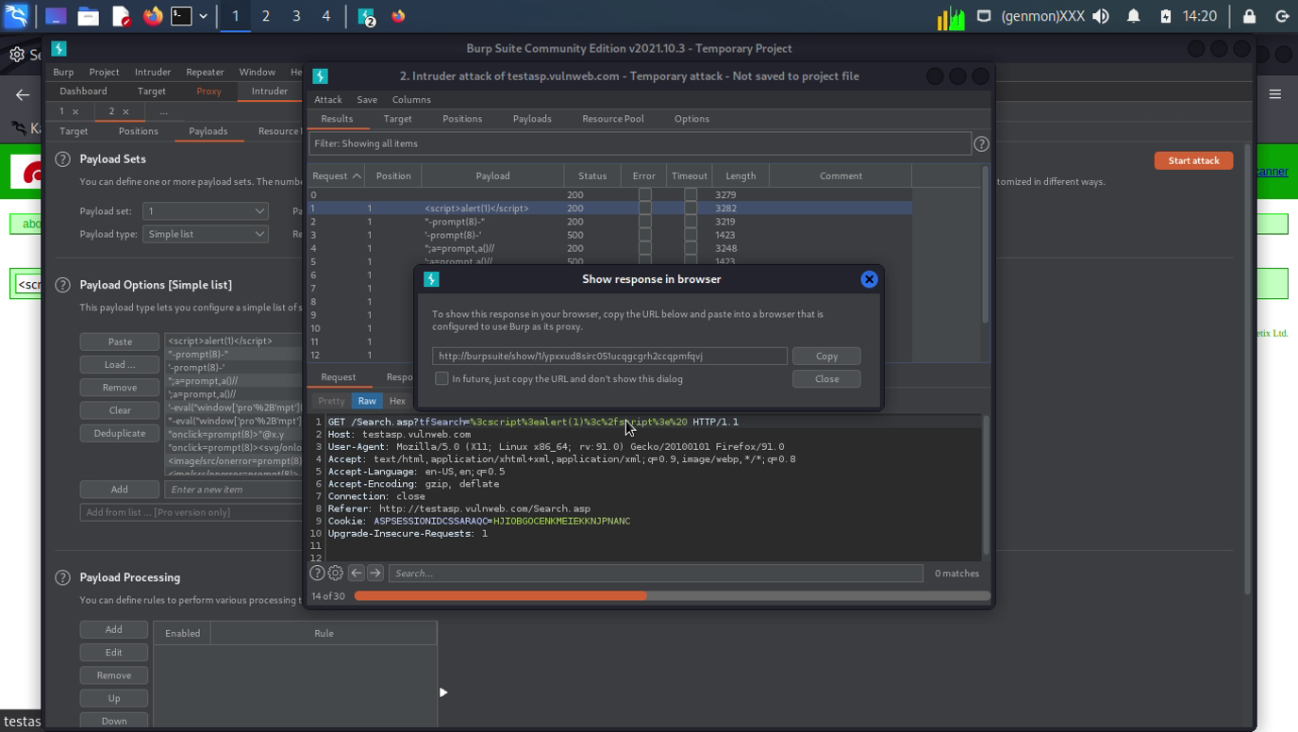
Command for Response in Browser

Slide 12
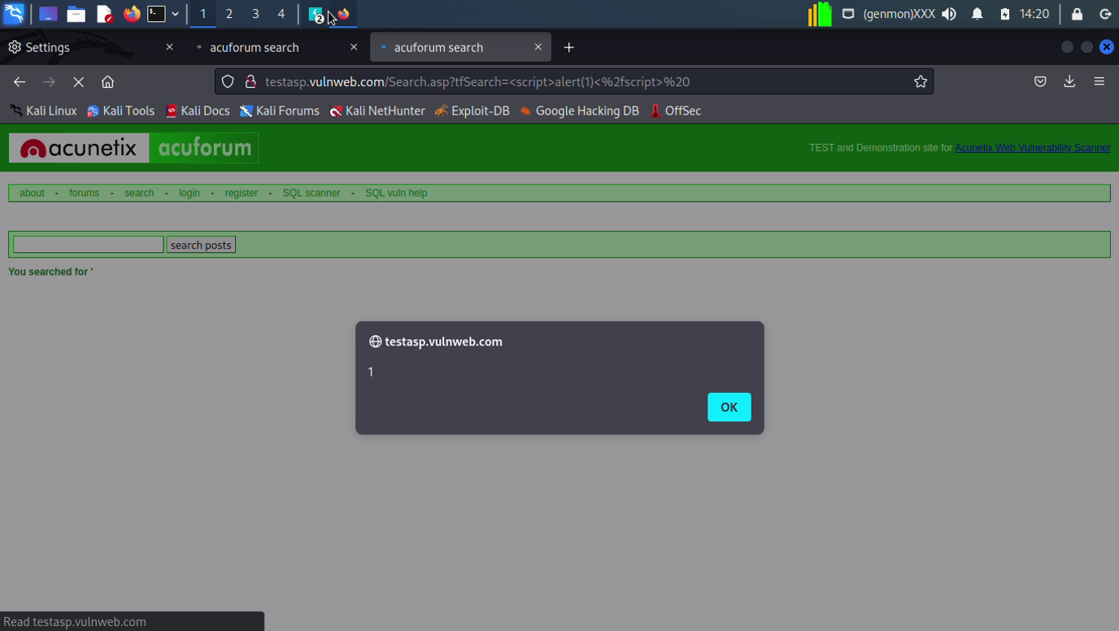
Vulnerability

Slide 13
THANK YOU

